Slide 1




Integrating AI in Distance Learning
DETA2025
WORKSHOP 2
Jody Joubert

Slide 2

Content
Short introduction
The Disclaimer
TeamUP
Level 1: What are mindtools
Level 2: Expert Group Activity
Level 3: Teaching Group Activity
Level 4: Dream Activity

Slide 3
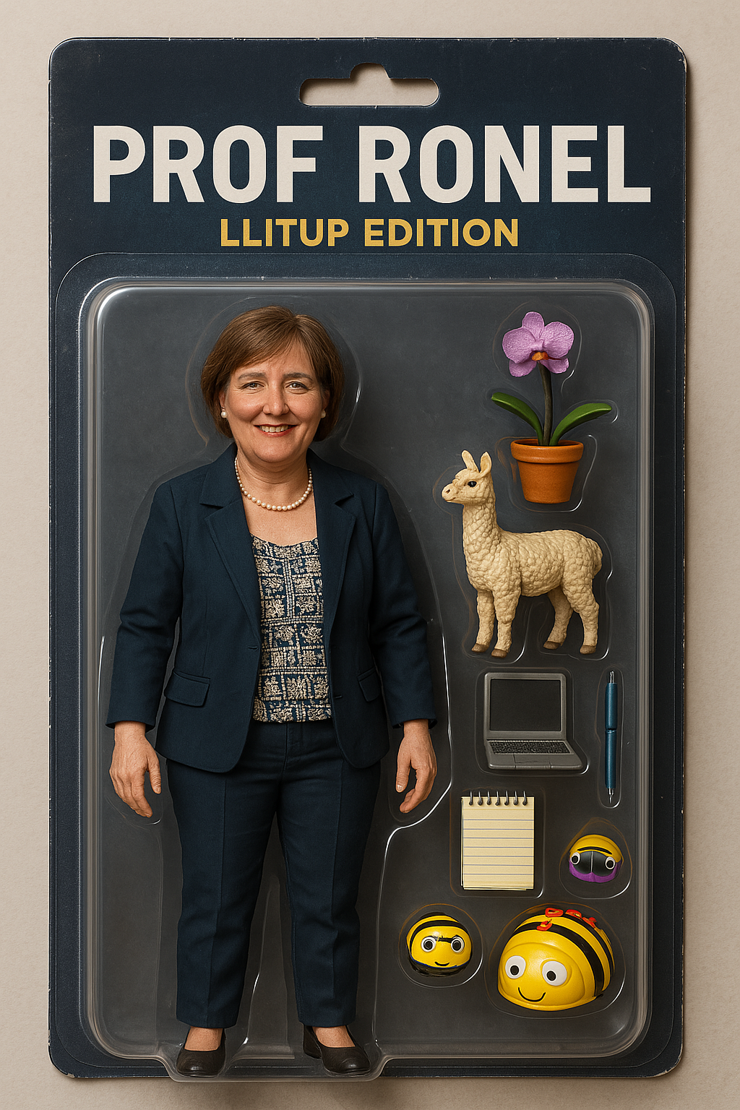
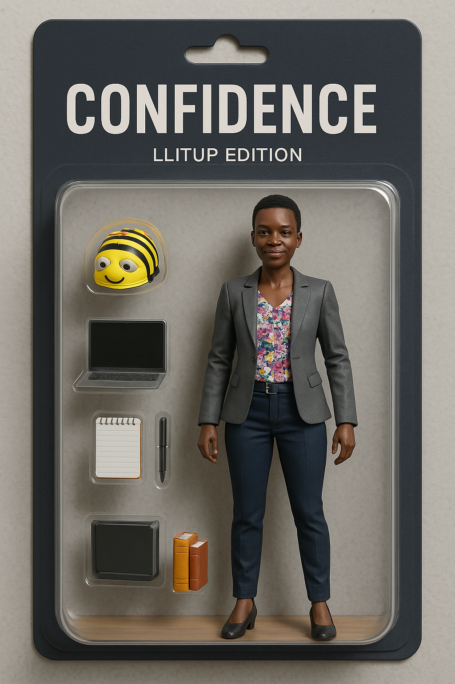
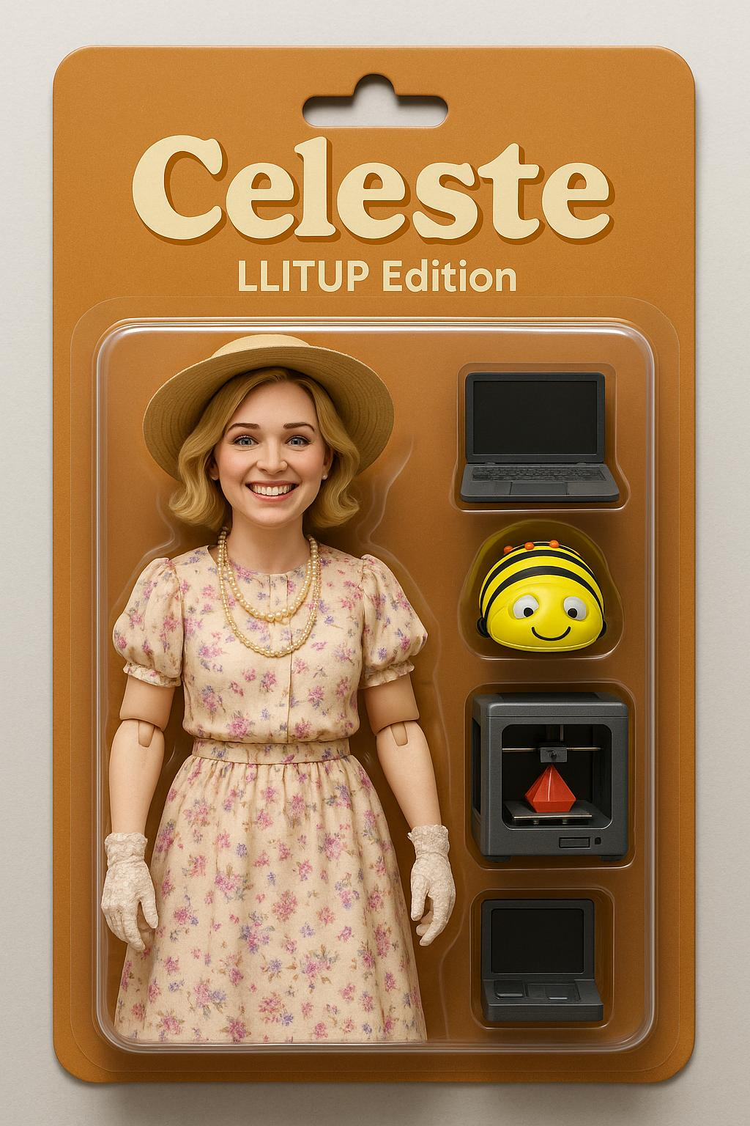
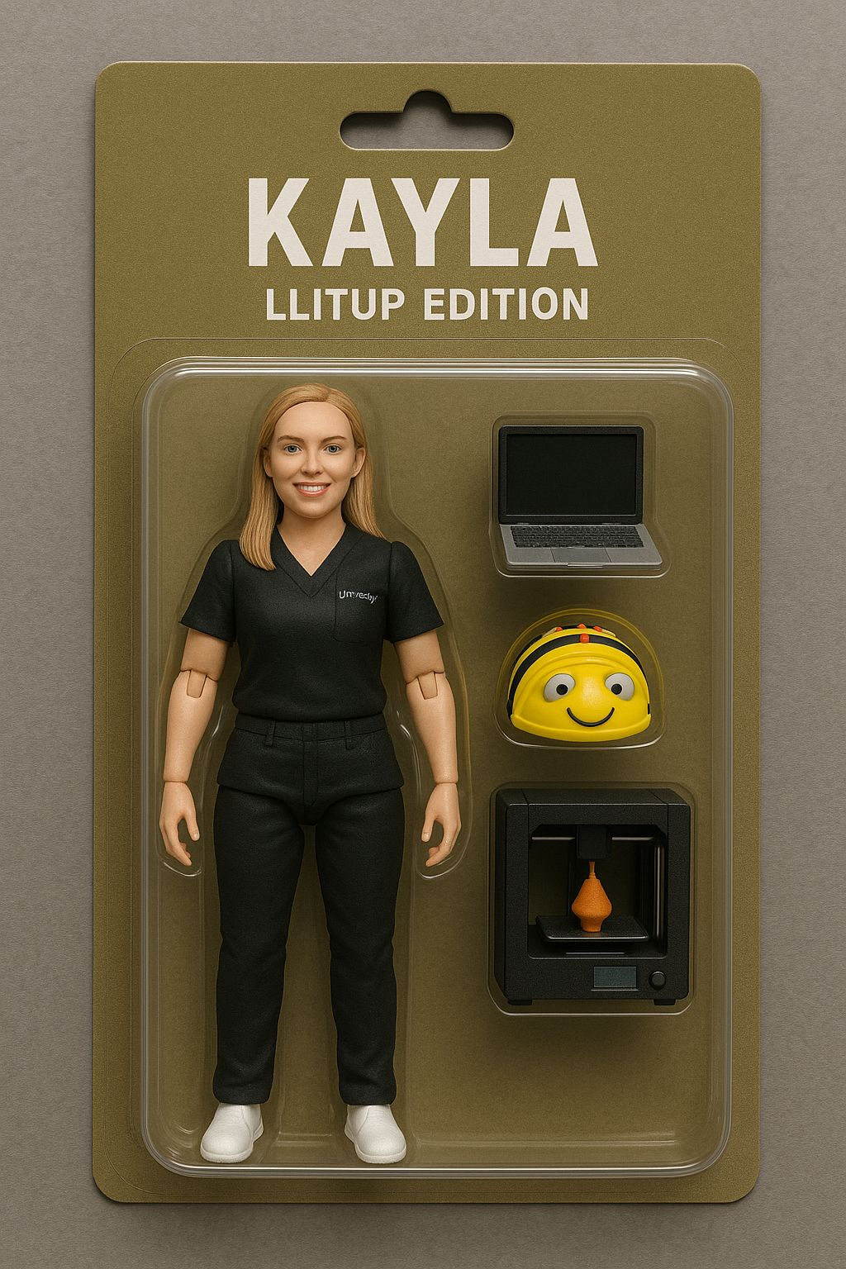
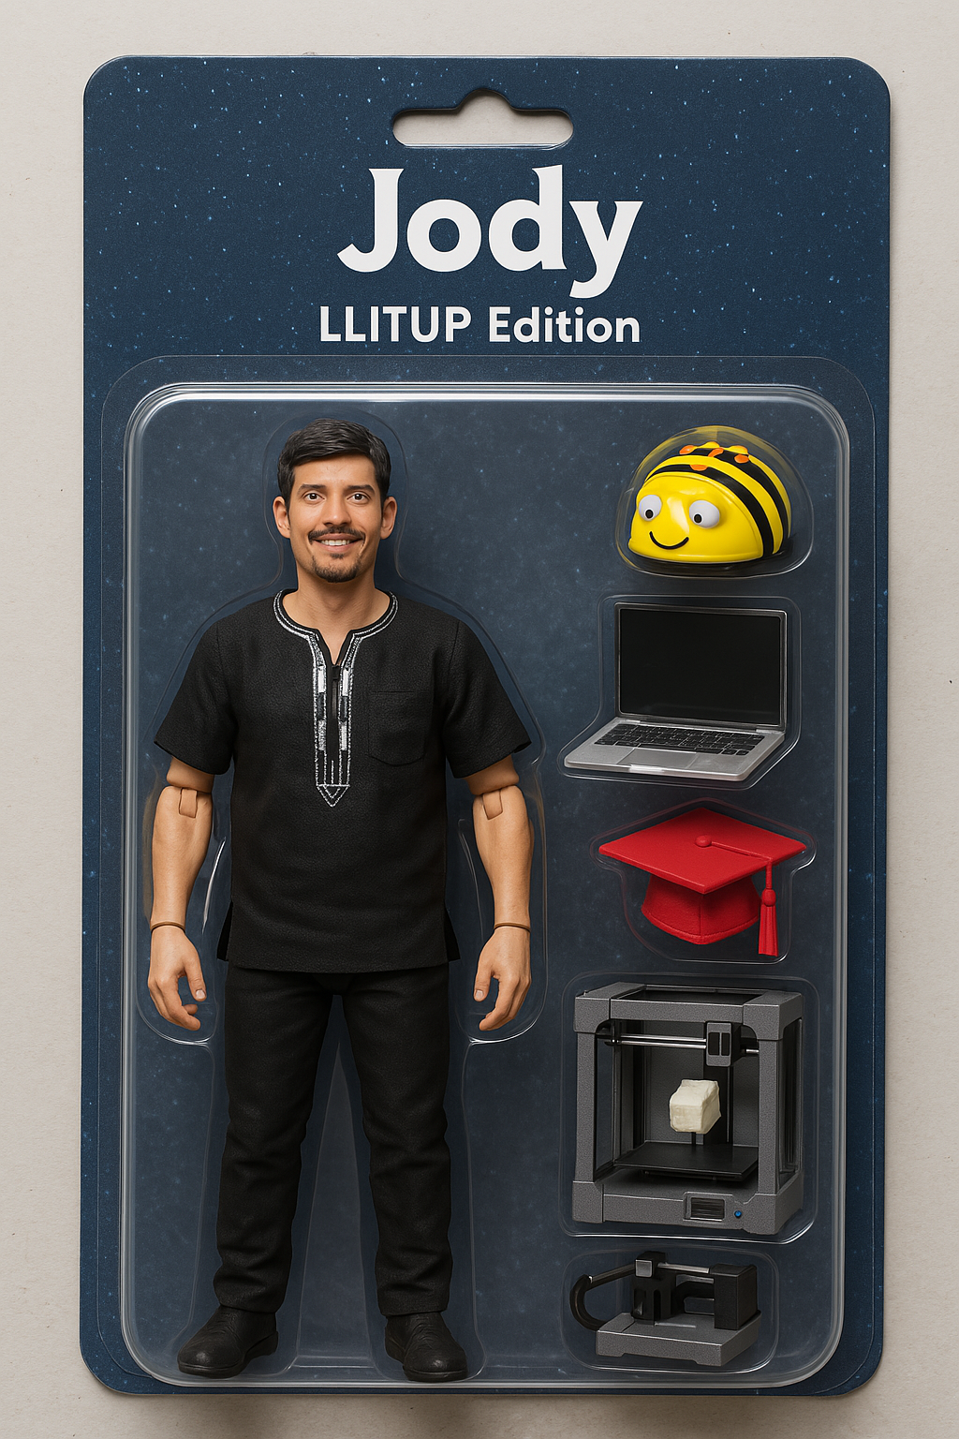
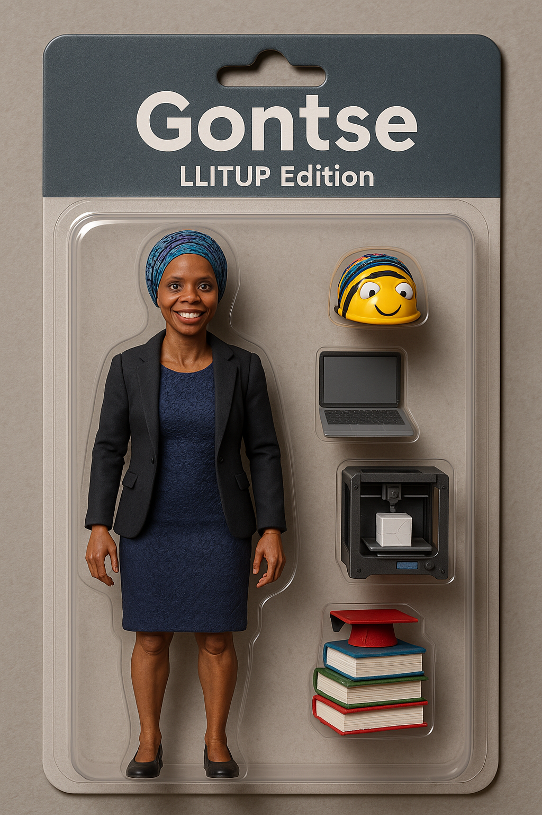
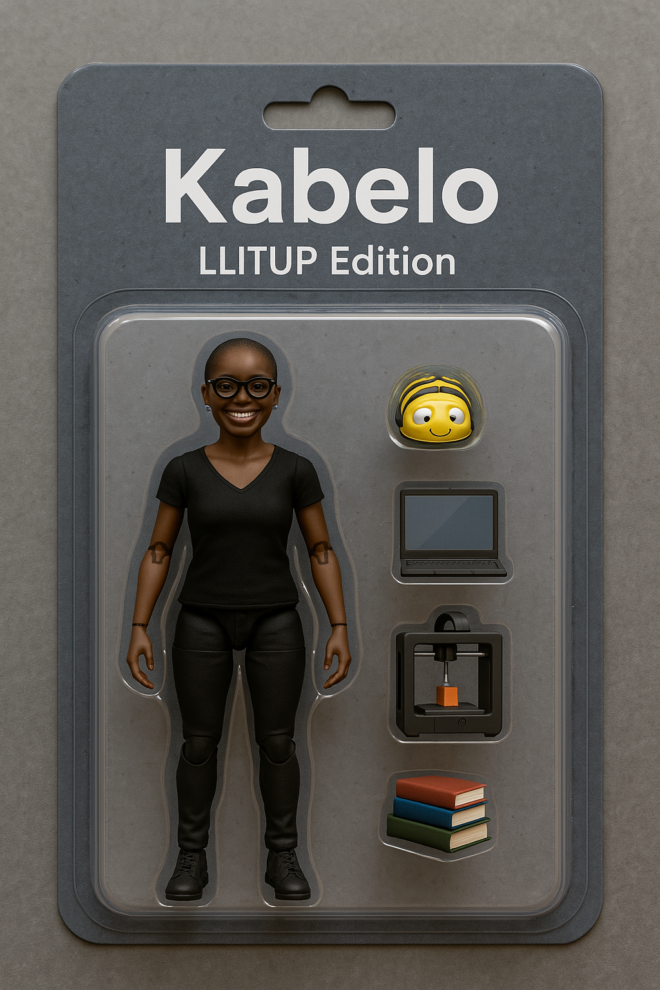

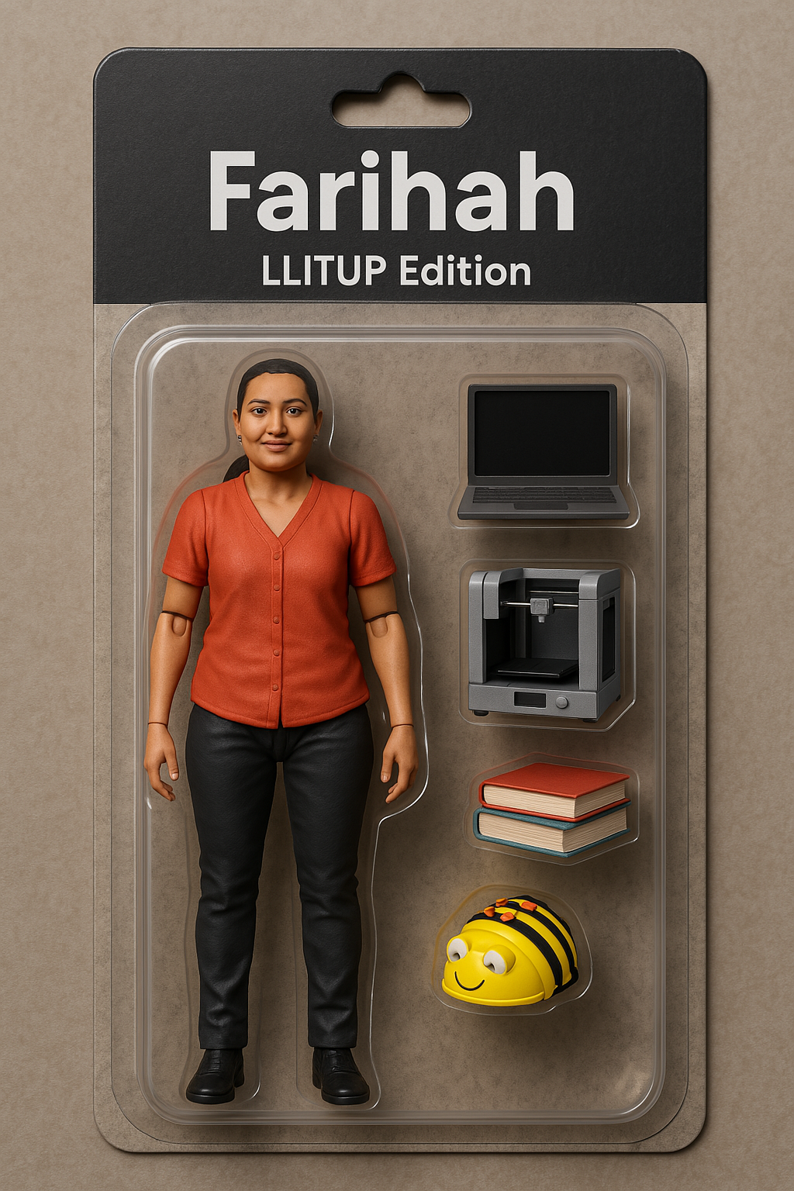
The LLITUP Team

Slide 4
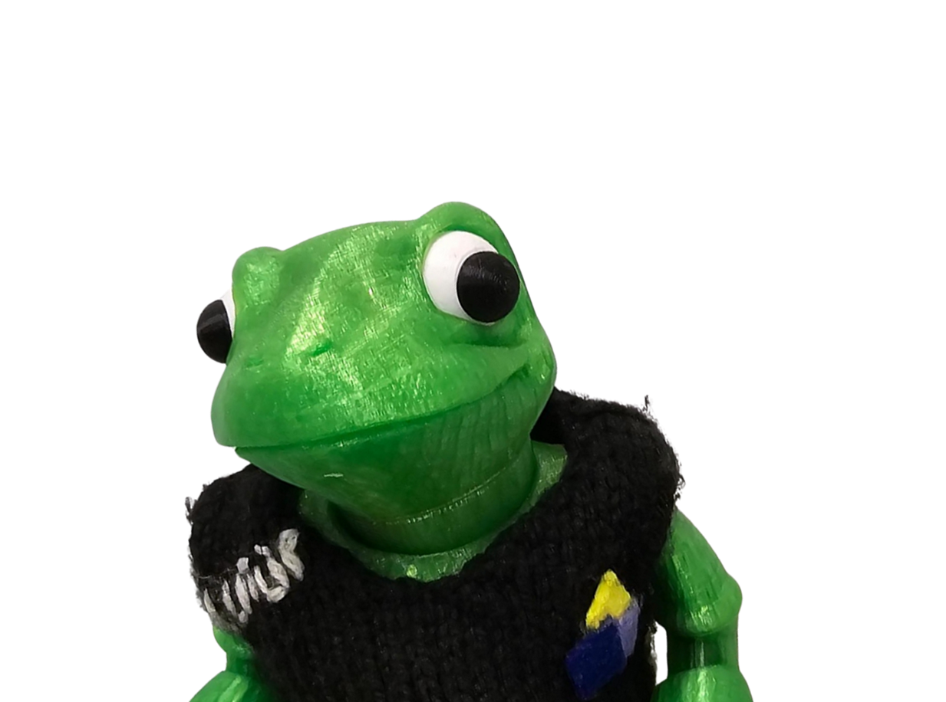
The LLITUP Team

Slide 5
LLITUP – Appreciative Inquiry
Venture
Impact
Initiate
Define
Destiny
LLITUP
Research unit
Co-create
Discover
Validate
Generate ideas
Design
Dream
Design

Slide 6
DREAM2
Play > Learn > Teach > Research

Slide 7
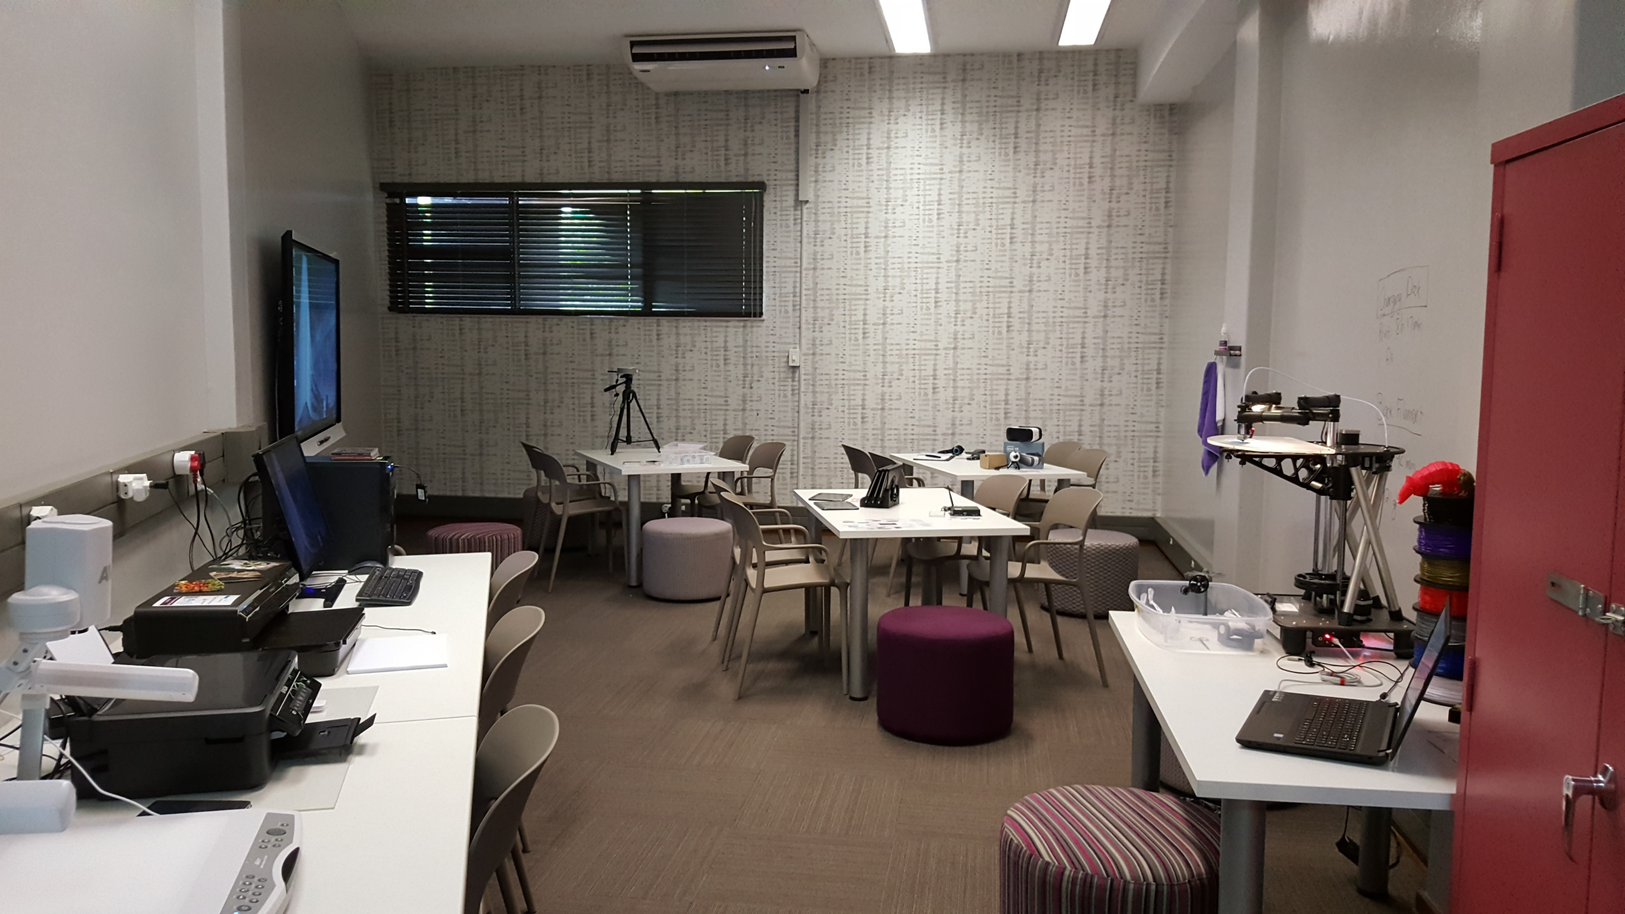
Our Collaboratorium

Slide 8

The Disclaimer…

Slide 9
Nature of the workshop
Hands-on
Team work
Externally paced
Game elements – Serious Game?
Interactive
Technology-integrated
Fun

Slide 10



Technology of Choice

Slide 11
What do you need
Laptop and/or Smartphone
ChatGPT; Claud; Gemini; etc.
QR Code scanning
WIFI/Internet connection
An interactive mood ☺

Slide 12

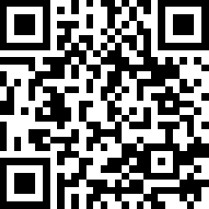

The Webpage
https://jodyjoubert.wixsite.com/deta2025

Slide 13
Now just before we start…

Slide 14


Slide 15
Level 1 is approaching…
Let’s get to our home groups.
More or less, but four is perfect.

Slide 16

LEVEL 1!

Slide 17
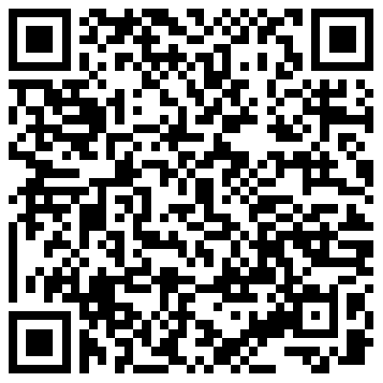
Unlock Computers as Mindtools

Slide 18
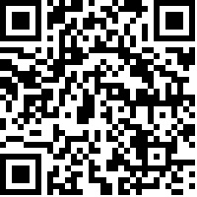
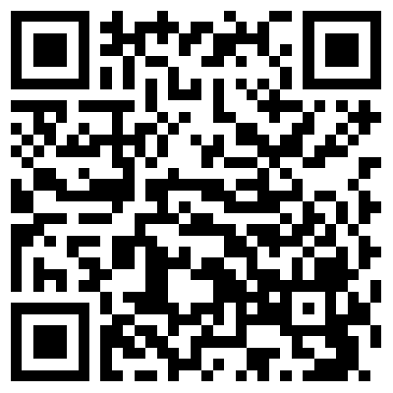
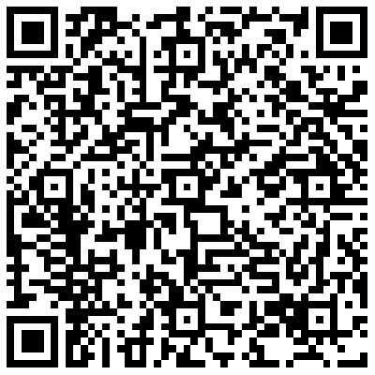
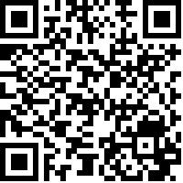
Four Puzzles…
Puzzle 1
Puzzle 2
Puzzle 3
Puzzle 4

Slide 19
Characteristics
Interactivity
Students are able to actively engage with the tool, not just receive information. It should prompt manipulation, experimentation, and play.

Slide 20
Characteristics
Representation
The tool must allow for the externalization of thinking—in visual, textual, symbolic, or otherwise interpretable form. It helps students represent what they know or are constructing.

Slide 21
Characteristics
Distributed Cognition
The tool extends the student’s cognitive capacity by offloading or scaffolding thinking, often making cognition shared between the students and the tool, or among learners via the tool.

Slide 22

LEVEL 2!

Slide 23

Goal
Produce a case insight document and a transcript of your thinking with ChatGPT to demonstrate understanding. Engage deeply with one real-world case of AI in distance education. Use ChatGPT and curated resources to uncover the practical applications, educational purpose, and alignment good practice.
Your group must produce two artifacts:
Your chat transcript (text-based, not screenshot)
Case Insight Document

Slide 24
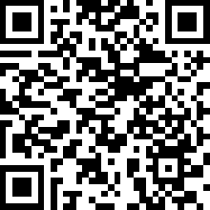
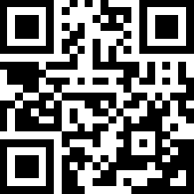
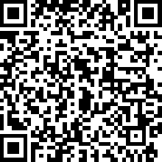
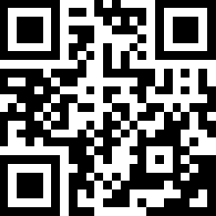
Your Case Articles
1
2
3
4

Slide 25
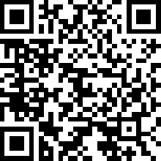
Your Case Summaries
Booklet
Website

Slide 26
SPET Model
Xu, X., Sun, Y., Weng, J., & Zhang, Y. (2023, November). Theoretical framework of personal learning environments: SPET model. In International Conference on Technology in Education (pp. 139-156). Singapore: Springer Nature Singapore.
Website

Slide 27
Computers as Mindtools
1. Jonassen, D. H. (1994). Technology as cognitive tools: Learners as designers. ITForum Paper, 1(1), 67-80.
2. Pakdaman-Savoji, A., Nesbit, J., & Gajdamaschko, N. (2019). The conceptualisation of cognitive tools in learning and technology:
A review. Australasian Journal of Educational Technology, 35(2).
Website

Slide 28

Your AI Partner
Debating Buddy
Faux Expert
Memory Partner
Clarifier

Slide 29

Guiding Questions

Slide 30


Your Two Artifacts

Slide 31



Slide 32

LEVEL 3!

Slide 33
Goal
Work across cases to collaboratively come up with practical ideas for how AI could be used in distance teacher training. Use ChatGPT as a thinking partner to guide your group’s reflection and surface design principles that are innovative, grounded, and appropriate to your own teaching context.
Your group must produce two artifacts:
Your chat transcript (text-based, not screenshot)
A list of practical ideas for good use of AI in distance education

Slide 34


Use the guidance provided

Slide 35
Your Two Artifacts

Slide 36
Assessment Demo

Slide 37
The “Marker” GPTs
Purpose-driven inputs
Clear rubrics and structured outputs
Human-centred tone and feedback logic
Thoughtfully selected test examples (and one deliberately untested)

Slide 38

LEVEL 4!

Slide 39
Goal
Envision how AI - especially GenAI tools like ChatGPT - can be creatively, meaningfully, and ethically integrated into your own (distance) education context. This is your chance to dream big, grounded in the insights you’ve gained so far.
You must produce two artifacts:
Your chat transcript (text-based, not screenshot)
Your A3 “Dream Sheet”

Slide 40
Use the guidance provided

Slide 41
Your Two Artifacts

Slide 42

Levels Complete

Slide 43
What did we learn about?
Computers as Mindtools
Appreciative Inquiry
Purposeful integration of AI
Society, Policy, Education and Technology (SPET)

Slide 44
Sharing GPTs – Just interesting ☺
No access to my conversations: People using my GPT cannot see my past chats with it.
Your GPT logic stays intact: They get the exact same rubric, tone, and instructions I configured.
They don’t need a Pro subscription, unless the GPT uses GPT-4 or pro-only features (which these rubric GPTs don’t).

Slide 45
Thanks!

Slide 46
Questions ?

Slide 47
The End

